Slide 1
Kaggle Project : Basics
ECE 4200
4/7/2020

Slide 2
OUTLINE
Wireless communication
Signals and Fourier Transform
Modulation Schemes
Details about the data

Slide 3
Wireless Communication

Slide 4
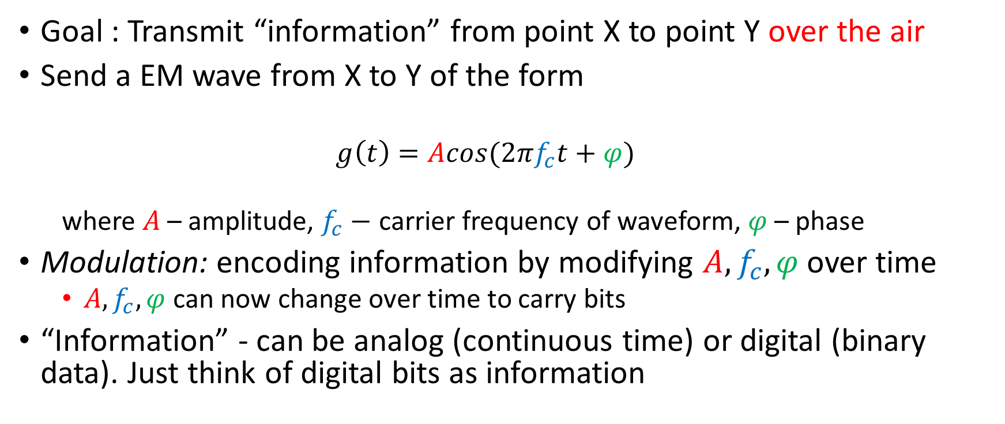
Wireless communication - Overview
Goal : Transmit “information” from point X to point Y over the air
Send a EM wave from X to Y of the form
$$g\left(t\right)=Acos(2πf_{c}t+φ)$$
where $A$ – amplitude, $f_{c}−$ carrier frequency of waveform, $φ$ – phase
Modulation: encoding information by modifying $A,f_{c},φ$ over time
$A,f_{c},φ$ can now change over time to carry bits
“Information” - can be analog (continuous time) or digital (binary data). Just think of digital bits as information

Slide 5
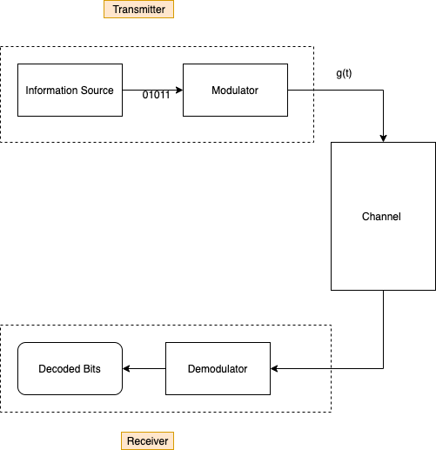
Point X -
Point X encodes the digital information (bits) into signals
The path from X to Y is the channel
Point Y tries to decode what was sent
BOTH X AND Y KNOW THE MODULATION SCHEME USED
Point Y -

Slide 6
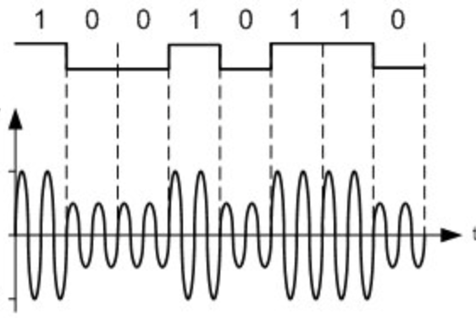
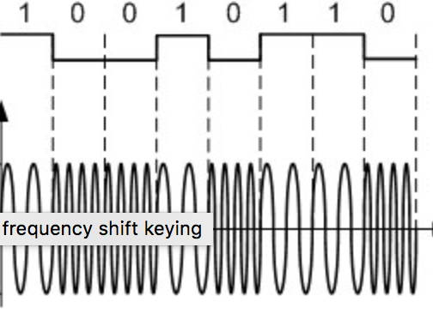
Examples
Y tries to decode the bits observing a noisy waveform

Slide 7

Signal-to-Noise Ratio
Sending signals introduces thermal noise and other distortions
Channel quality measured by Signal-Noise-Ratio
$$SNR(\text{in} \text{dB}\text{)}=\text{10 }\log_{10}\left(\frac{P_{signal}}{P_{noise}}\right)$$

Slide 8
Signals and Fourier Transform

Slide 9
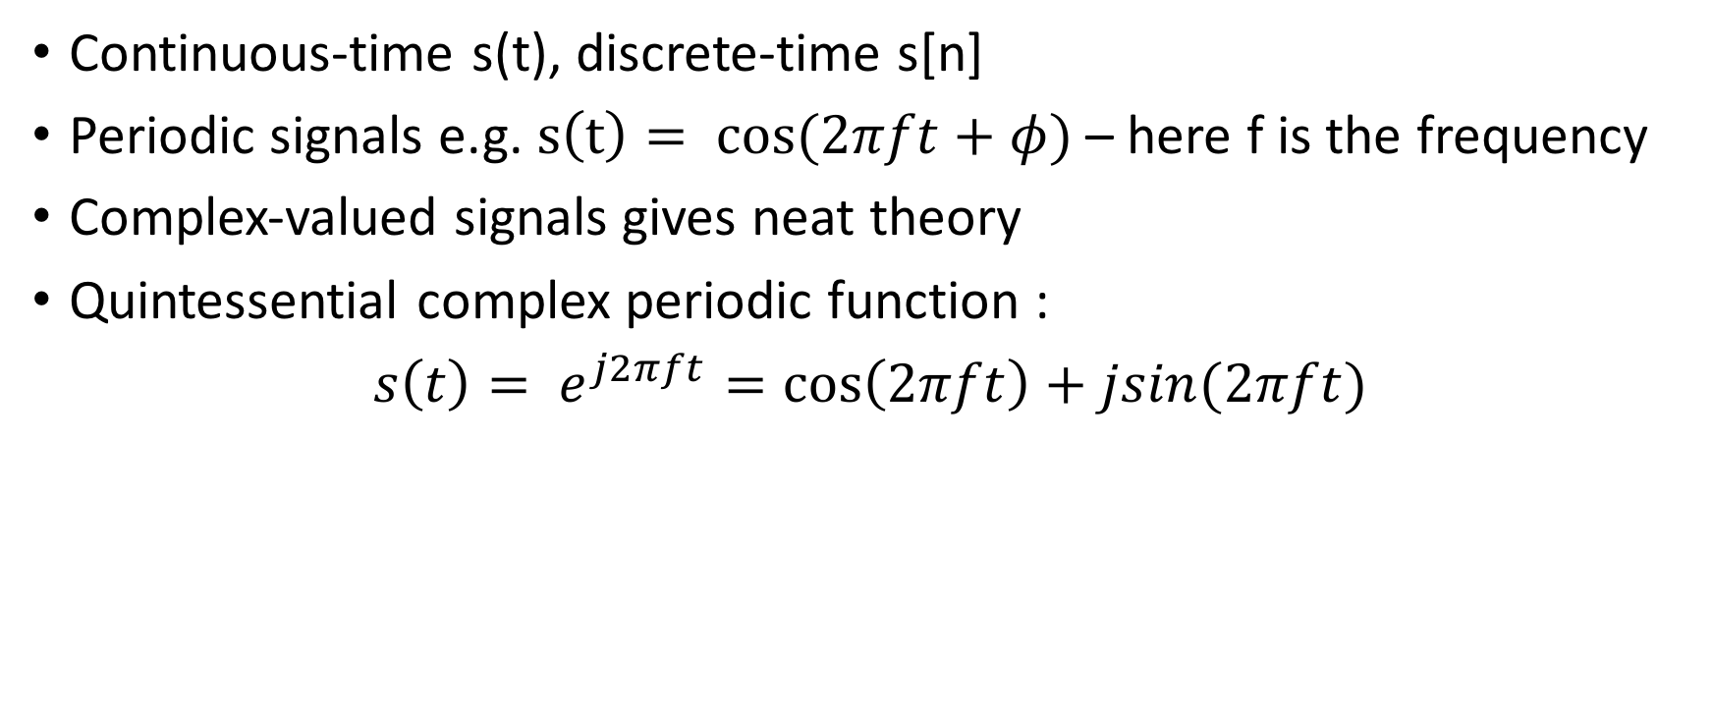
Signals
Continuous-time s(t), discrete-time s[n]
Periodic signals e.g. $s\left(t\right)= cos⁡(2πft+φ)$ – here f is the frequency
Complex-valued signals gives neat theory
Quintessential complex periodic function :
${s\left(t\right)= e}^{j2πft}=\cos\left(2πft\right)+jsin(2πft)$

Slide 10
Frequency Domain – Fourier Transform
Time-domain signals not always informative
Any signal decomposes as a sum of periodic signals of different frequencies
Time Domain Signal <=> Collection of frequencies of constituent periodic signals -> “Spectrum” or Frequency domain representation
Switching between time-domain and frequency domain – Fourier Transform
Useful tool to obtain features

Slide 11
Fourier Transform - Implementation
Signals in the computer are by default discrete-time
Discrete Fourier Transform (DFT) – efficient version is FFT
Numpy has a fft library that takes in a complex array and outputs the FFT
import numpy as np
train_data_cmplx = train_data[:,:,0] + 1j*train_data[:,:,1]
fft_train_data = np.fft.fft(train_data_cmplx,axis=1)

Slide 12
Modulation Schemes

Slide 13
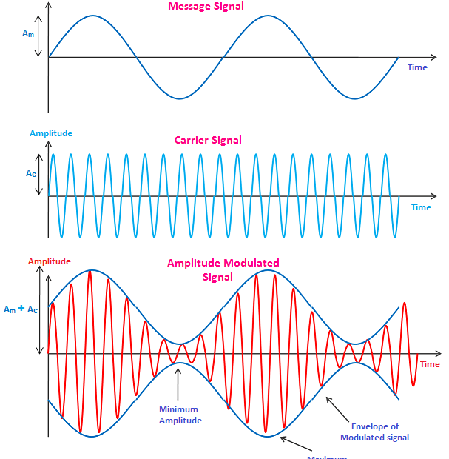
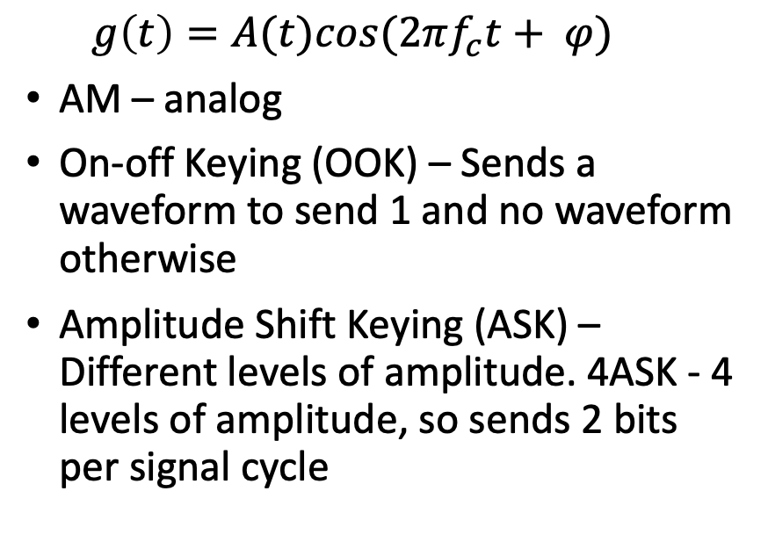
Amplitude Modulation schemes
$$g\left(t\right)=A(t)cos(2πf_{c}t+ φ)$$
AM – analog
On-off Keying (OOK) – Sends a waveform to send 1 and no waveform otherwise
Amplitude Shift Keying (ASK) – Different levels of amplitude. 4ASK - 4 levels of amplitude, so sends 2 bits per signal cycle

Slide 14
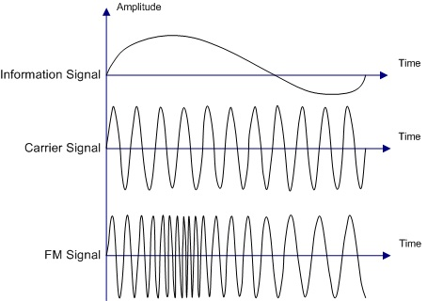

Frequency Modulation Schemes
$g\left(t\right)=Acos(2πf_{c}(t)t+ φ)$
FM – Analog

Slide 15
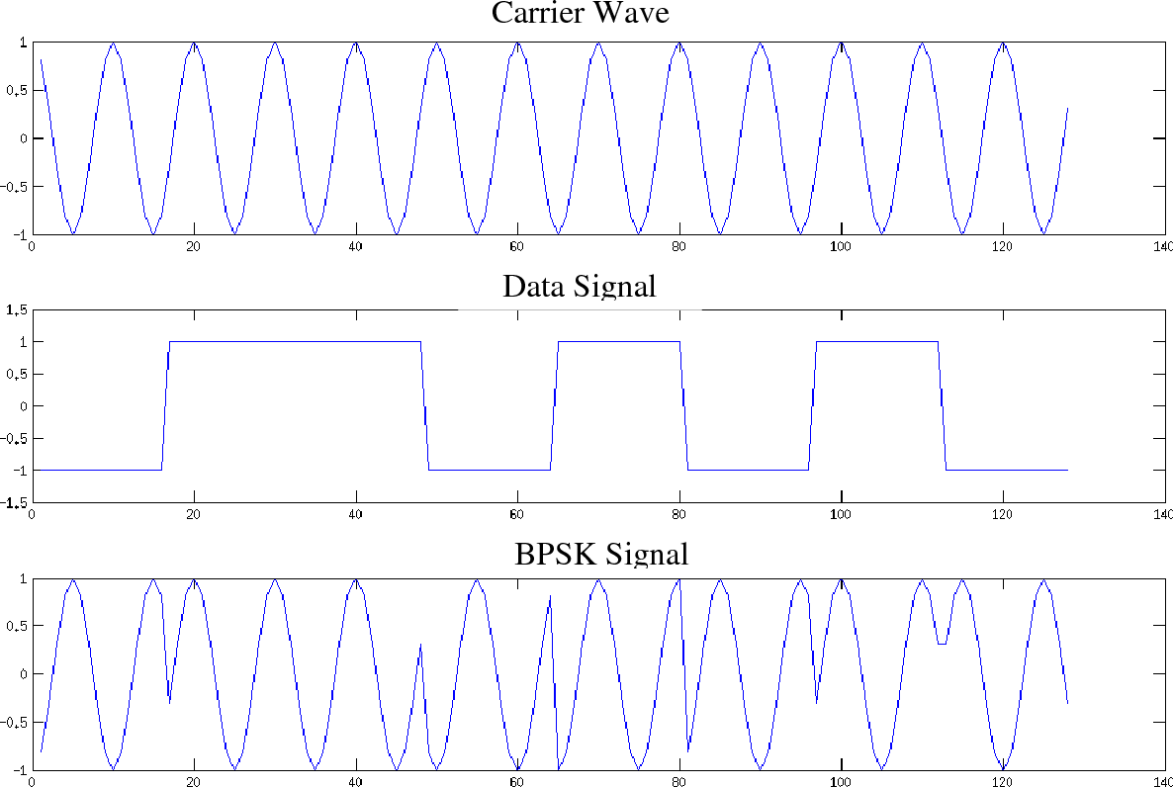
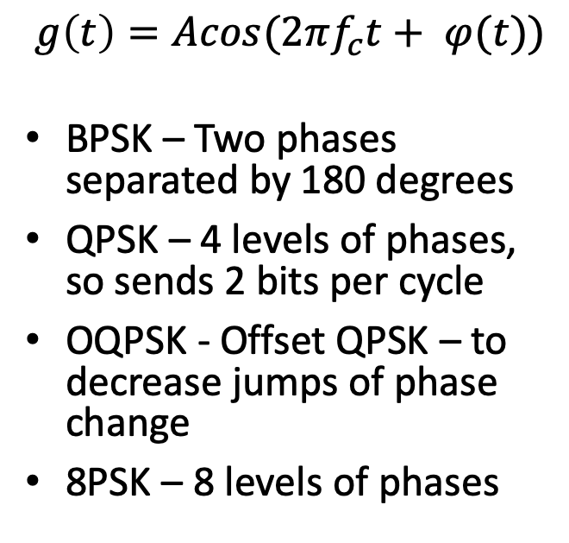
Phase Modulation Schemes
$$g\left(t\right)=Acos(2πf_{c}t+ φ(t))$$
BPSK – Two phases separated by 180 degrees
QPSK – 4 levels of phases, so sends 2 bits per cycle
OQPSK - Offset QPSK – to decrease jumps of phase change
8PSK – 8 levels of phases

Slide 16
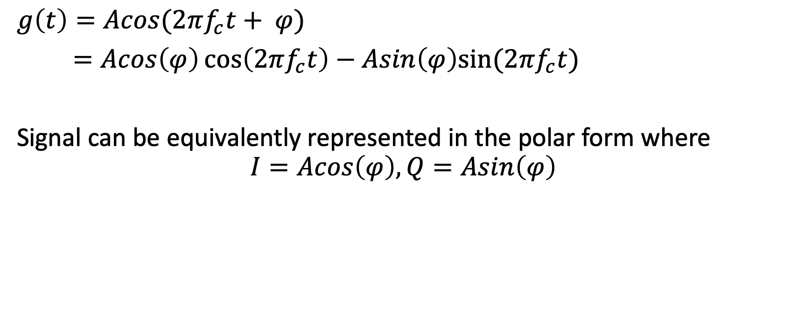
I/Q representation
$$g\left(t\right)=Acos(2πf_{c}t+ φ)$$
$=Acos\left(φ\right)\cos\left(2πf_{c}t\right)−Asin\left(φ\right)sin⁡(2πf_{c}t)$
Signal can be equivalently represented in the polar form where
$$I=Acos\left(φ\right), Q=Asin\left(φ\right)$$

Slide 17
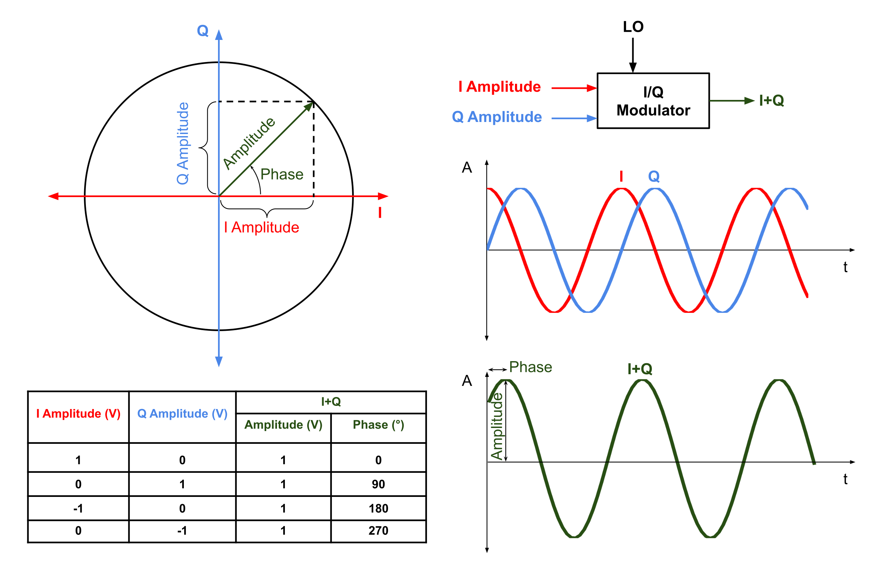

Slide 18
Details about the Data

Slide 19
30,000 training samples, 20,000 test samples
Each train/test sample generated by following method
Generate random bits
Modulate using corresponding modulation scheme
Transmit to radio receiver through either
1) Software Simulated Noisy Channel
2) Over-the-air transmission
Record received signals for a short time interval giving 1024 I/Q samples
Each train/test sample is sent at a specific SNR value ranging from -20dB to 30dB
Further details can be found at https://ieeexplore.ieee.org/stamp/stamp.jsp?tp=&arnumber=8267032

